Slide 1

50.051 Programming Language Concepts W11-S3 Semantic Analysis(Part 2) and intermediate code representation
Matthieu De Mari

Slide 2
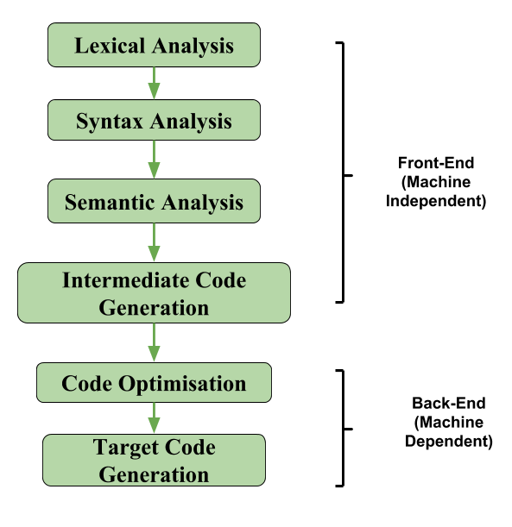
The front-end of a compiler
Semantic Analysis
Final step in the “front-end” phase, whose job is to check that the source code is legal.
Ensures that the program has a well-defined meaning.
Should catch all remaining errors that lexical analysis and syntax analysis could not catch.
Errors that require contextual information about the code.

Slide 3
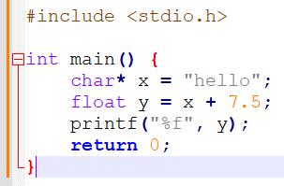
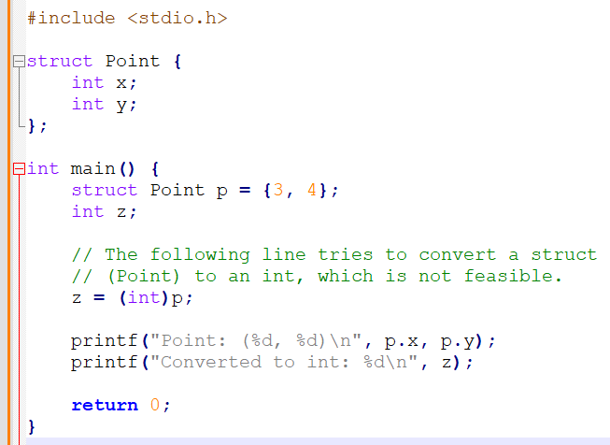
Examples of remaining errors
Type problems
An operation attempts to combine two invalid types together (e.g. summing a string and a float together).
An operation attempts to convert a variable of a certain type in another type that is not feasible.
Etc.

Slide 4
Examples of remaining errors
Important fact: These errors cannot be checked during the lexical analysis or the syntax analysis, as they require some context.
Cannot be checked by a context-free (duh!) grammar.
Often depends on values and context, not syntax.
May sometimes require and involve computation.
What to do then?
Instead, will need to define a set of semantic rules for scoping and types explicitly.
And then, perform additional checks after parsing.
These checks will be implemented in the form of “if-else” checks.

Slide 5
Semantic analysis and ASTs
Objective: The answer to the semantic problems
Scope problems,
Type problems,
And more,…
And the checks to be conducted, both rely on the Abstract Syntax Tree produced by the syntax analysis step.

Slide 6
What are Types?
Definition (type):
This is a difficult definition, by here is my attempt.
A type is a classification that defines a set of values and the operations that can be performed on variables of said type (e.g. types methods and operators behaviours) .
It also defines a way to encode said information about the variable in the memory (e.g. char, short, long, int, etc.)
In short, the purpose of a types system is to provide a way to describe and reason about data and their behaviour within a program.

Slide 7
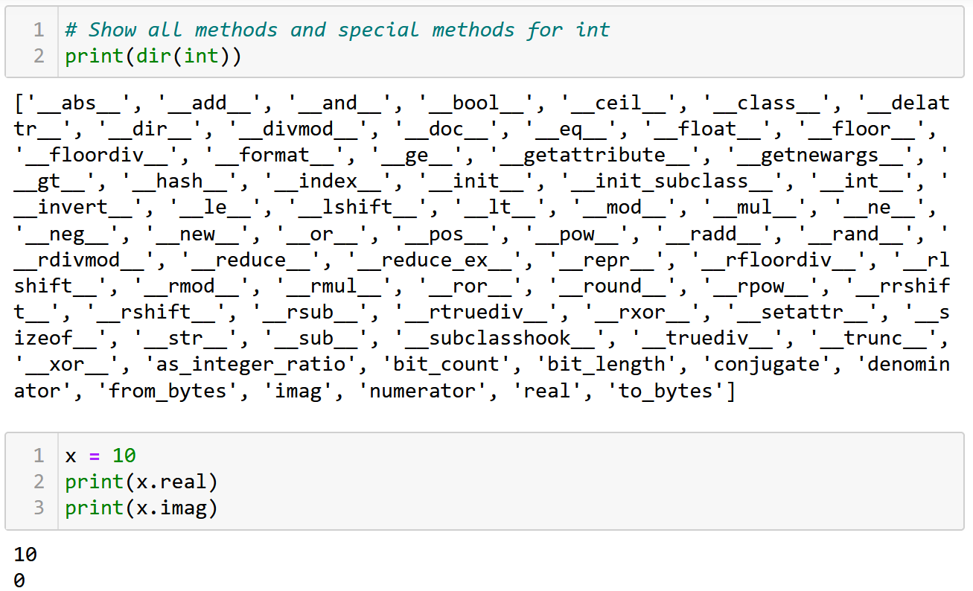
What are Types?
Definition (type):
This is a difficult definition, by here is my attempt.
A type is a classification that defines a set of values and the operations that can be performed on variables of said type (e.g. types methods and operators behaviours) .
It also defines a way to encode said information about the variable in the memory (e.g. char, short, long, int, long long, etc.)
In short, the purpose of a types system is to provide a way to describe and reason about data and their behaviour within a program.

Slide 8
Strong vs. weak type systems
Definition (Strong type system):
A strong type system strictly enforces rules about which types can be used in specific operations and contexts.
In languages with a strong type system, we typically see more explicit type declarations, and the compiler or runtime will enforce type constraints, often causing errors when there is a type mismatch.
This helps catch potential errors early, as well as promotes code readability and allows for better optimization.

Slide 9
Strong vs. weak type systems
Definition (Weak type system):
A weak type system is more lenient with type enforcement.
In languages with a weak type system, you may see implicit type conversions (coercions) and less strict rules about which types can be used in certain operations.
This can lead to more flexibility and shorter code, but also introduces the risk of subtle bugs and less predictable behaviour.
For instance, Python allows things like “x = True and 1”. It resolves the type mismatch (bool and int) by performing an implicit conversion of the int 1 into a Boolean. Might not be allowed in other languages.

Slide 10
Implicit vs. Explicit type conversion
Definition (Implicit type conversion):
Implicit type conversion, also known as type coercion or automatic type conversion, occurs when the compiler or runtime automatically converts a value of one type to another type without the programmer explicitly requesting the conversion.
This typically happens when performing operations with operands of different types, and the language's type system automatically promotes or converts one of the values to match the other.
Implicit type conversions can make code more concise, but they can also introduce unexpected behaviour if the conversion rules are not well-defined or understood.

Slide 11
Implicit vs. Explicit type conversion
Definition (Explicit type conversion):
Explicit type conversion, also known as type casting or manual type conversion, occurs when the programmer explicitly requests the conversion of a value from one type to another using language-specific syntax or functions.
This is often necessary in languages with strong type systems that do not allow implicit type conversions or when the programmer wants to override the default behaviour of implicit conversions.
Explicit type conversions provide more control and predictability, but they can also make the code more verbose and may introduce errors if not used carefully.

Slide 12
Strong vs. weak type systems
Strong vs. Weak defines a spectrum (not a binary classification).
C: will allow to sum together a char and an int, same thing with a float and an int. An implicit conversion will happen.
Python: will allow to sum together a float and an int using an implicit conversion. The char and int addition is not straightforward and requires an explicit Unicode conversion of the char using ord().
Strict languages (e.g. Haskell): will simply refuse to operate if the types do not exactly match.

Slide 13
Strong vs. weak type systems
Strong vs. Weak defines a spectrum (not a binary classification).
C: will allow to sum together a char and an int, same thing with a float and an int. An implicit conversion will happen.
Python: will allow to sum together a float and an int using an implicit conversion. The char and int addition is not straightforward and requires an explicit Unicode conversion of the char using ord().
Strict languages (e.g. Haskell): will simply refuse to operate if the types do not exactly match. Explicit conversions only.
Which is better then? Another open debate, for you to decide!

Slide 14
Types errors
Type errors will typically occur in the following two scenarios:
An explicit method or operation is used on a type that does not support it (e.g. in Python the explicit conversion of a string “123.4” into int, using + operation between int ”7” and string “hello”, calling append() method on string, etc.).
There is no implicit conversion that might resolve the issue above, if any (e.g. summing a char “c” and an int “7” in C, will simply require an implicit conversion, but this will not do in Python).
This can be implemented with an “if-else” again and a set of rules on the basic types in our language.

Slide 15
Static vs Dynamic type checking
Definition (Static vs. Dynamic type checking):
In Static Type Checking, types are checked at compile-time, errors are caught before program execution (e.g., Java, C++).
In Dynamic Type Checking, types are checked at run-time, errors are caught during program execution (e.g., Python, JavaScript).
In No (or None?) Type Checking, types are not checked and everything is processed in binary! (Ok, maybe not the best idea).
Which one is best? Another open debate.

Slide 16
Endless debate
There is an endless debate about the best type system to use.
Dynamic type checking systems make it easier to prototype.
Static type checking systems have fewer bugs.
None type checking is quite frankly a terrible idea.
Strongly-typed languages are often more robust.
Weakly-typed systems are often faster.
I am staying out of this!

Slide 17
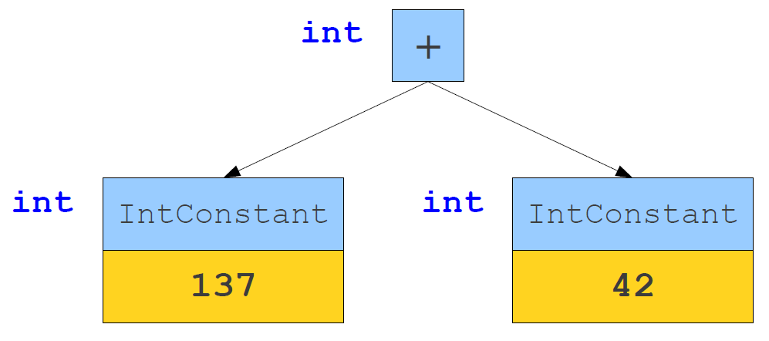
Types inference
Definition (types inference):
The bread-and-butter concept behind a types system is types inference, that is a logical set of pre-established rules that will define the behaviour to use for any operation on any given type.

Slide 18
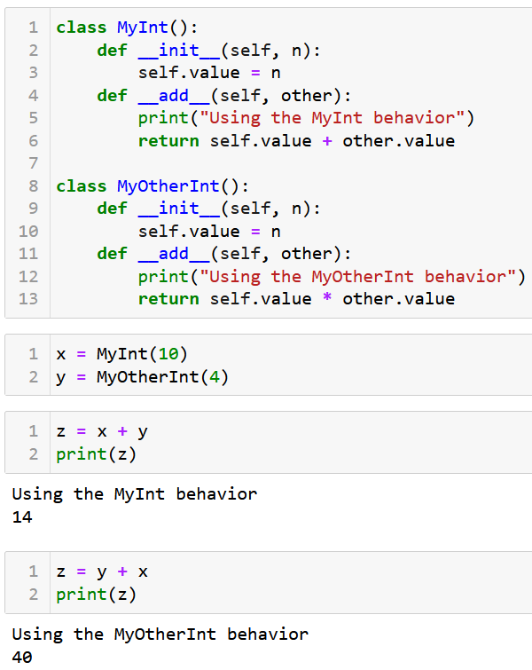
Types inference for operators (Python)
The case of Python
In the case of operators (+, *, -, /, etc.), the behaviour of a given operation “x operator y” is often decided by looking at the left-hand variable type first and calling its special method for said operator, here __add__().

Slide 19
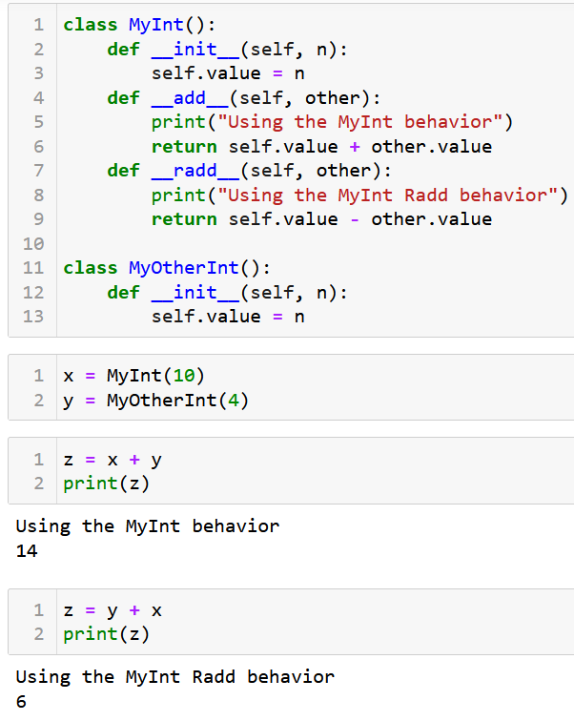
Types inference for operators (Python)
The case of Python
In the case of operators (+, *, -, /, etc.), the behaviour of a given operation “x operator y” is often decided by looking at the left-hand variable type first and calling its special method for said operator, here __add__().
If __add__() is not defined for left-hand type, try using the __radd__() for right-hand type.

Slide 20
Types inference for operators (Python)
The case of Python
In the case of operators (+, *, -, /, etc.), the behaviour of a given operation “x operator y” is often decided by looking at the left-hand variable type first and calling its special method for said operator, here __add__().
If __add__() is not defined for left-hand type, try using the __radd__() for right-hand type.
This behaviour is Python has to do with the way they designed their object-oriented structure for the programming language.
It defines clear types inferences rules for operator overloading.
It is, however, not universal and not the only framework.

Slide 21
Types inference for operators (C)
The case of C
In C, operator behaviour is different.
C follows specific rules for type promotion and conversion when performing operations with different types.
For example, when adding an int and a float, C will implicitly convert the int to a float before performing the addition.
Behaviour of operators in C is determined by the language's type system and promotion rules, rather than the left-hand operand's type alone.

Slide 22
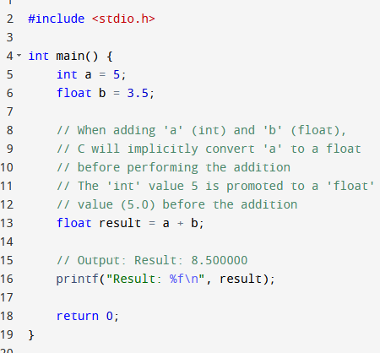
Types inference for operators (C)
The case of C
In C, operator behaviour is different.
C follows specific rules for type promotion and conversion when performing operations with different types.
For example, when adding an int and a float, C will implicitly convert the int to a float before performing the addition.
Behaviour of operators in C is determined by the language's type system and promotion rules, rather than the left-hand operand's type alone.

Slide 23
Types inference for operators (C++)
The case of C
In C, operator behaviour is different.
C follows specific rules for type promotion and conversion when performing operations with different types.
For example, when adding an int and a float, C will implicitly convert the int to a float before performing the addition.
Behaviour of operators in C is determined by the language's type system and promotion rules, rather than the left-hand operand's type alone.
To some extent, operator overloading can also be made in C++ for custom objects (to be seen later).

Slide 24
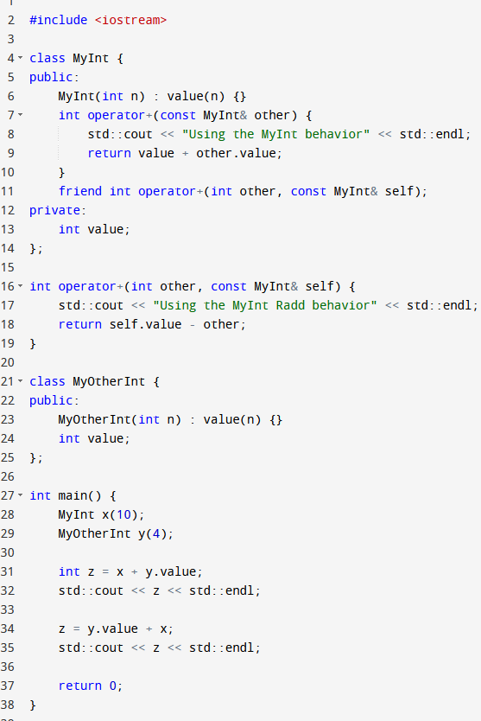
Types inference for operators (C++)
The case of C
In C, operator behaviour is different.
C follows specific rules for type promotion and conversion when performing operations with different types.
For example, when adding an int and a float, C will implicitly convert the int to a float before performing the addition.
Behaviour of operators in C is determined by the language's type system and promotion rules, rather than the left-hand operand's type alone.
To some extent, operator overloading can also be made in C++ for custom objects (to be seen later).

Slide 25
Type Checking as Proofs
We can think of type checking in semantic analysis as proving claims about the types of expressions.
We begin with a set of axioms, then apply our inference rules to determine the types of expressions.
Many type systems can be thought of as proof systems.
Typically defined as ‘If … Then …” statements.

Slide 26
Some examples of types inference rules
Some examples of types inferences rules.
“If x is an identifier that refers to an object of type T, the expression x has type T.”
“If e is an integer constant, e has type int.”
“If the operands e1 and e2 of e1 + e2 are known to have types int and int, then e1 + e2 has type int.”

Slide 27
Formalism for Type Inference
We will represent our axioms and inference rules using the formalism below.
It reads as “If preconditions are true, then we can infer postconditions are true.”
We also denote “S ⊢ e : T” if the expression e in scope S has type T.
Preconditions
Postconditions

Slide 28
Formalism for Type Inference
We will represent our axioms and inference rules using the formalism below.
It reads as “If preconditions are true, then we can infer postconditions are true.”
We also denote “S ⊢ e : T” if the expression e in scope S has type T.
Preconditions
Postconditions

Slide 29
Some examples of types inference rules
Some examples of types inferences rules.
“True is of type Boolean, whatever the scope is (no preconditions).”
“If e is an integer constant in scope S, then e has type int.”
⊢ true : bool
e is an integer constant
S ⊢ e : int

Slide 30
Some examples of types inference rules
Some examples of types inferences rules
“If the operands e1 and e2 of the operation e1 + e2 are known to have types int and int, then e1 + e2 has type int.”
S ⊢ e1 : int S ⊢ e2 : int
S ⊢ e1 + e2 : int

Slide 31
Some examples of types inference rules
Some examples of types inferences rules.
“If the operands e1 and e2 of the operation e1 + e2 are known to have types int and float, then e1 + e2 has type float, but will require e1 to be converted implicitly to float.”
Can be used to introduce implicit conversions of types!
S ⊢ e1 : int S ⊢ e2 : float
S ⊢ e1 : float S ⊢ e1 + e2 : float

Slide 32
Operations tables
Many times, these rules can be assembled in result types tables, where each cell will indicate
If the operation is allowed,
What is the resulting type,
What is the operation to use for said types
If any implicit conversions must be made.
Op: + | bool | int | float | string
bool | ... | ... | ... | ...
int | ... | ... | ... | ...
float | ... | ... | ... | ...
string | ... | ... | ... | ...

Slide 33
Op: +, rows are left operand, columns are right operand. | bool | int | float | string
bool | Res: bool Behavior: or | Convert int to bool Res: bool Behavior: or | Convert float to bool Res: bool Behavior: or | Convert string to bool? Res: bool Behavior: or
int | Convert int to bool Res: bool Behavior: or | Res: int Behavior: math. addition | Convert int to float Res: float Behavior: math. Addition | Illegal, should trigger a type error
float | Convert float to bool Res: bool Behavior: or | Convert int to float Res: float Behavior: math. addition | Res: float Behavior: math. addition | Illegal, should trigger a type error
string | Convert string to bool? Res: bool Behavior: or | Illegal, should trigger a type error | Illegal, should trigger a type error | Res: string Behavior: concatenation

Slide 34
Some examples of types inference rules
When an identifier (e.g. a variable with name x) is called, a lookup procedure will check the symbol table for a given scope S (or multiple ones if LEGB).
Can also be used to resolve resulting types of operations mixing constants and identifiers!
x is in identifier called in scope S x appears in scope S with type int (S ⊢ x : int) S ⊢ 7 : int
S ⊢ x + 7 : int

Slide 35
Some examples of types inference rules
What if the identifier refers to a function?
Can also be used to resolve resulting types of function calls!
f is in identifier called in scope S f appears in scope S as a non-member function f expects types (T1, … , Tn) and returns type U S ⊢ ei : Ti for 1 <= i <= n
S ⊢ f(e1, …,en) : U

Slide 36
Some examples of types inference rules
Also works on Compound types (e.g. arrays) and their operations, for instance indexing.
Question about array bounds and index checking: Semantic analysis should also include checking that array indices are within bounds to avoid out-of-bounds errors at runtime. How would you modify statement above to illustrate that?
S ⊢ e1 : T[] S ⊢ e2 : int
S ⊢ e1[e2]: T

Slide 37
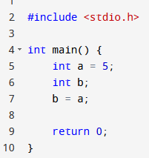
Some examples of types inference rules
How about assignments?
Question: Is this rule good enough to approve the assignment procedures in the code shown on the right ?
S ⊢ e1 : T S ⊢ e2 : T
S ⊢ e1 = e2 : T

Slide 38
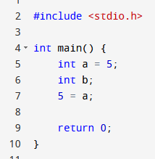
Some examples of types inference rules
How about assignments?
Question 2: How about this?
Is “5 = a;” an acceptable syntax? And, therefore, something that would have escaped the syntax analysis phase?
S ⊢ e1 : T S ⊢ e2 : T
S ⊢ e1 = e2 : T

Slide 39
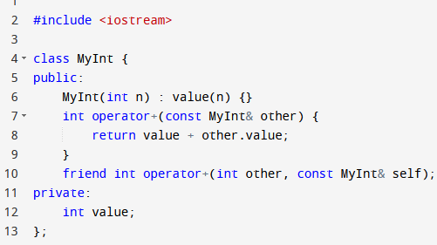
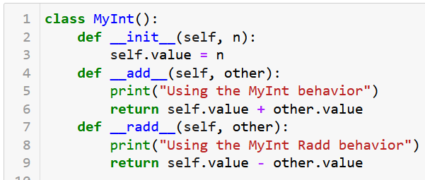
Defining custom classes
How do we factor in, any new classes the user might have defined into our inference rules?
Let us start with the simplest case, a custom class that does not inherit from anybody.

Slide 40
Defining custom classes
Let us start with the simplest case, a custom class that does not inherit from anybody.
In both cases, these class statements indicate to the compiler that there is a new type in town now, on top of the built-in ones!
Operator methods basically tell the compiler to amend operations table and account for new possible + behaviour!

Slide 41
Op: + | bool | int | float | string | MyInt
bool | Res: bool Behavior: or | Convert int to bool Res: bool Behavior: or | Convert float to bool Res: bool Behavior: or | Convert string to bool? Res: bool Behavior: or | Illegal, trigger a type error
int | Convert int to bool Res: bool Behavior: or | Res: int Behavior: math. addition | Convert int to bool Res: float Behavior: math. addition | Illegal, should trigger a type error | Illegal, trigger a type error
float | Convert float to bool Res: bool Behavior: or | Convert int to bool Res: float Behavior: math. addition | Res: float Behavior: math. addition | Illegal, should trigger a type error | Illegal, trigger a type error
string | Convert string to bool? Res: bool Behavior: or | Illegal, trigger a type error | Illegal, trigger a type error | Res: string Behavior: concatenation | Illegal, trigger a type error
MyInt | Illegal, should trigger a type error | Illegal, trigger a type error | Illegal, trigger a type error | Illegal, trigger a type error | Res: int Behavior: in add method of MyInt class

Slide 42
Defining custom classes
Instructor
Assist. Prof.
TA
Lecturer
Simon
Matt
How do we factor in, any new classes the user might have defined into our inference rules?
How about classes that inherit from a single other class or type?
Will have to factor in the possible inheritance conversions for types and methods.

Slide 43
Properties of inheritance structures
In the definitions below, “convertible” means that type A can be converted to type B, 100% of the time (no shenanigans).
Reflexivity: Any type is convertible to itself.
Transitivity: If A is convertible to B and B is convertible to C, then A is convertible to C.
Antisymmetry: if A is convertible to B and B is convertible to A, then A and B are the same.

Slide 44
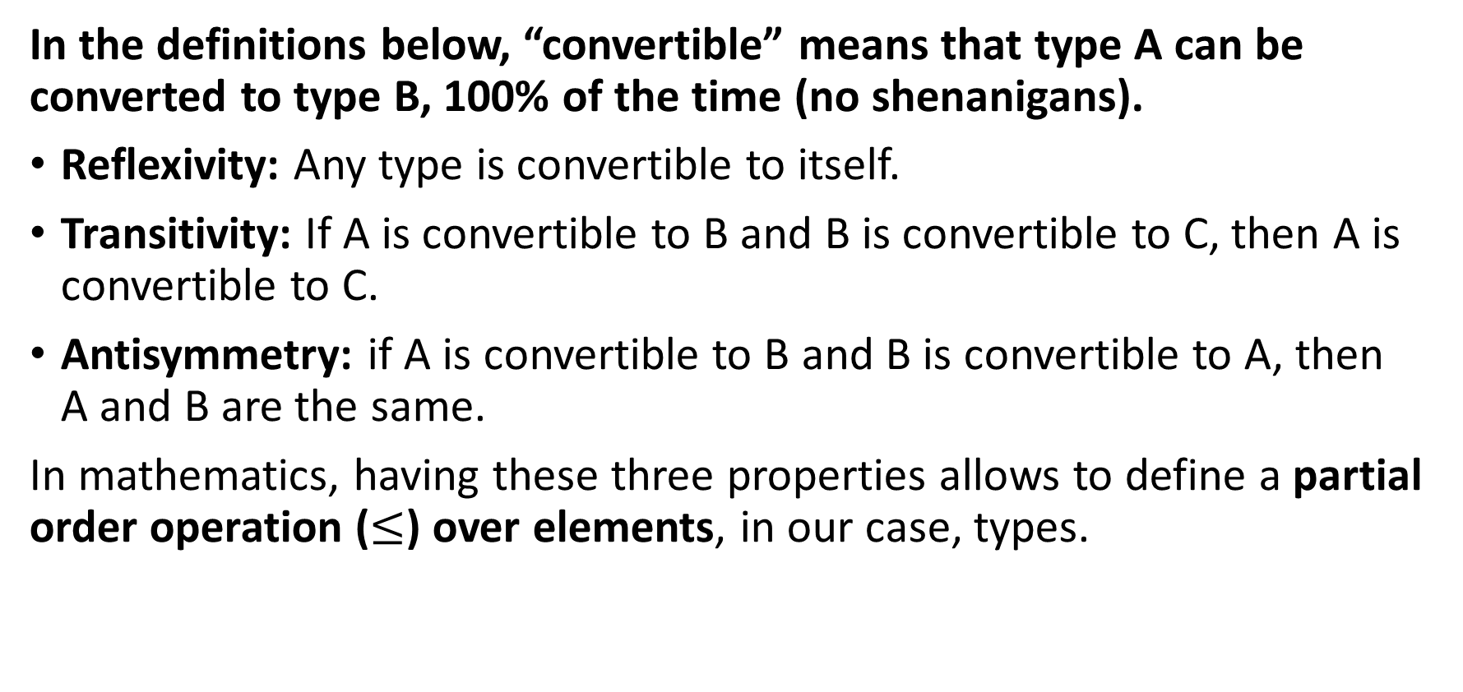
Properties of inheritance structures
In the definitions below, “convertible” means that type A can be converted to type B, 100% of the time (no shenanigans).
Reflexivity: Any type is convertible to itself.
Transitivity: If A is convertible to B and B is convertible to C, then A is convertible to C.
Antisymmetry: if A is convertible to B and B is convertible to A, then A and B are the same.
In mathematics, having these three properties allows to define a partial order operation ($≤$) over elements, in our case, types.

Slide 45
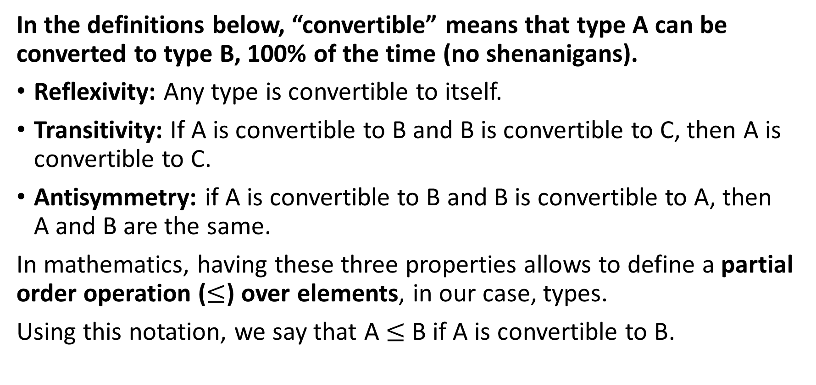
Properties of inheritance structures
In the definitions below, “convertible” means that type A can be converted to type B, 100% of the time (no shenanigans).
Reflexivity: Any type is convertible to itself.
Transitivity: If A is convertible to B and B is convertible to C, then A is convertible to C.
Antisymmetry: if A is convertible to B and B is convertible to A, then A and B are the same.
In mathematics, having these three properties allows to define a partial order operation ($≤$) over elements, in our case, types.
Using this notation, we say that A $≤$ B if A is convertible to B.

Slide 46
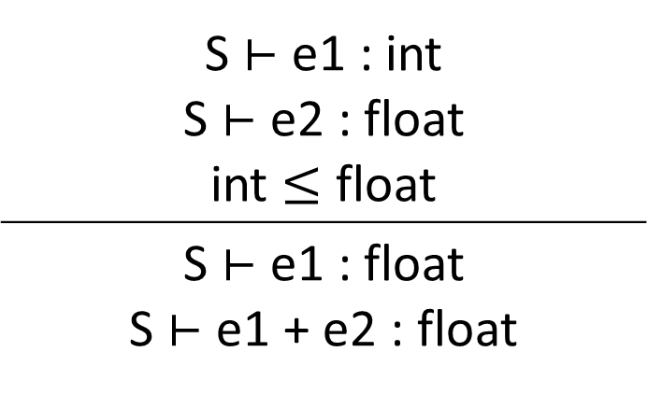

Properties of inheritance structures
This idea and the notation $≤$can be used to provide order among types and define possible implicit conversion rules in operations.
Typically added to operations tables!
S ⊢ e1 : int S ⊢ e2 : float int $≤$ float
S ⊢ e1 : float S ⊢ e1 + e2 : float

Slide 47
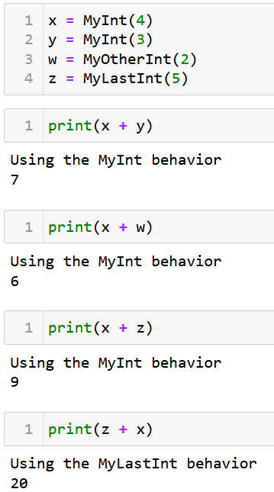
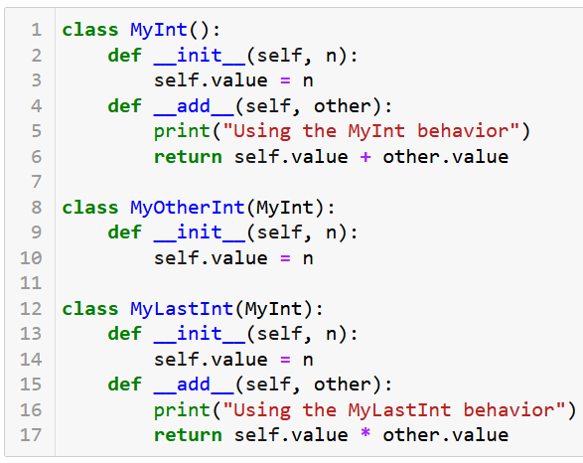
Careful about operations overloading

Slide 48
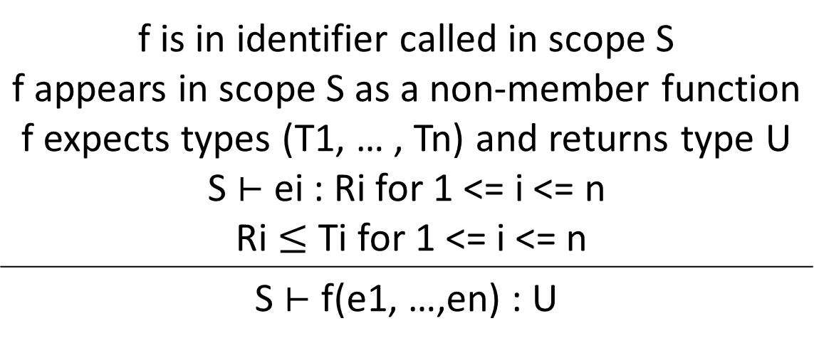
Some examples of types inference rules
Updated functions calls with implicit types conversions
f is in identifier called in scope S f appears in scope S as a non-member function f expects types (T1, … , Tn) and returns type U S ⊢ ei : Ri for 1 <= i <= n Ri $≤$ Ti for 1 <= i <= n
S ⊢ f(e1, …,en) : U

Slide 49
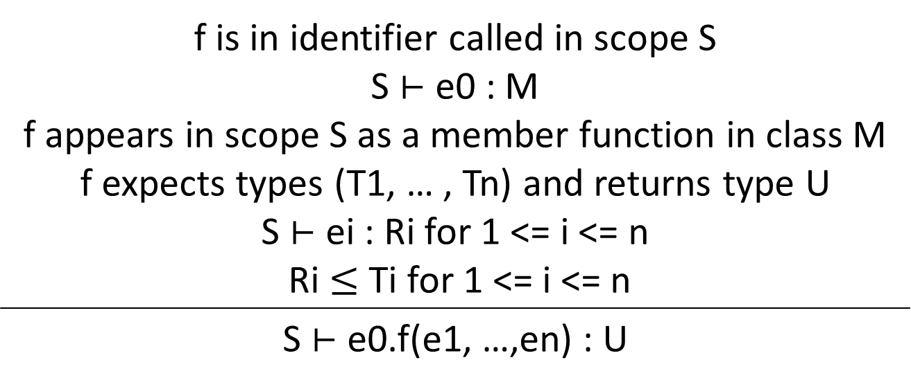
Some examples of types inference rules
Updated functions calls with implicit types conversions and member functions/methods of a class
f is in identifier called in scope S S ⊢ e0 : M f appears in scope S as a member function in class M f expects types (T1, … , Tn) and returns type U S ⊢ ei : Ri for 1 <= i <= n Ri $≤$ Ti for 1 <= i <= n
S ⊢ e0.f(e1, …,en) : U

Slide 50
Some examples of types inference rules
Open Question: How would you modify this to ensure that f is a method of class e0 or any parent class than e0 inherits from?
f is in identifier called in scope S S ⊢ e0 : M f appears in scope S as a member function in class M f expects types (T1, … , Tn) and returns type U S ⊢ ei : Ri for 1 <= i <= n Ri $≤$ Ti for 1 <= i <= n
S ⊢ e0.f(e1, …,en) : U

Slide 51
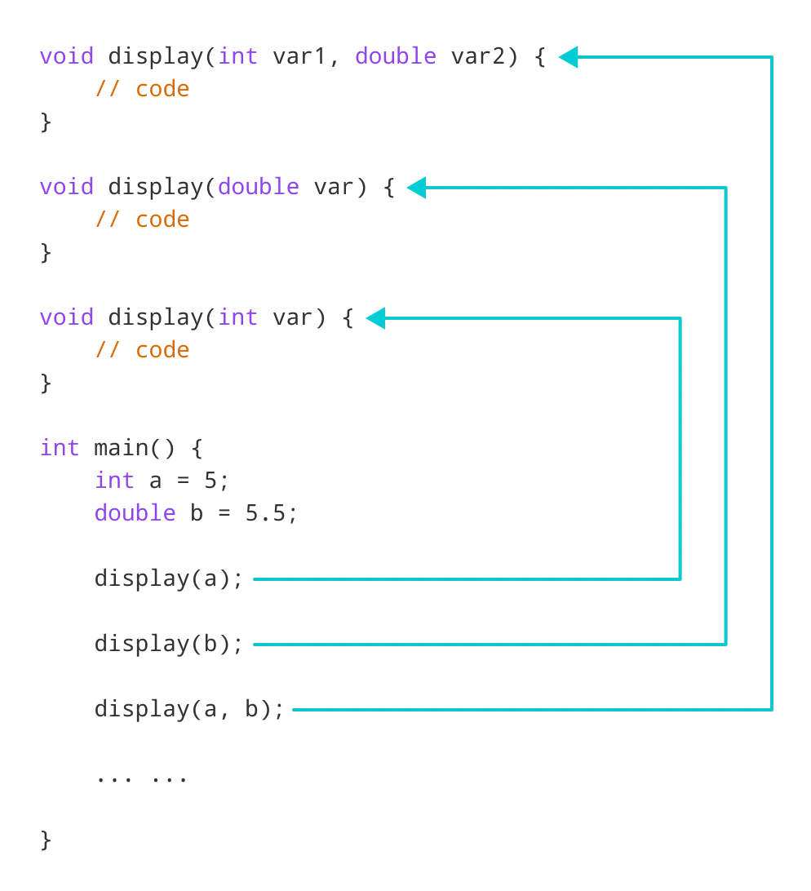
Defining custom classes
How do we factor in, any new classes the user might have defined into our inference rules?
Open question #1: How about classes that inherit from a multiple other classes or types?
Usually starts to become a mess at this point! (Which is why I am not really a big fan of multiple inheritance…)
Open question #2: How about function overloading/polymorphism?

Slide 52
Error reporting and recovery
Type errors will typically occur in these two scenarios:
An explicit method or operation is used on a type that does not support it (e.g. in Python the explicit conversion of a string “123.4” into int, using + operation between int ”7” and string “hello”, calling append() method on string, etc.).
There is no implicit conversion that might resolve the issue above, if any (e.g. summing a char “c” and an int “7” in C, will simply require an implicit conversion, but this will not do in Python).
This can be implemented with an “if-else” again and a set of rules we have defined we our types inference framework and tables.

Slide 53
Compiler Error Recovery
Definition (Compiler Error Recovery):
In modern compilers, compiler error recovery refers to the process of attempting to continue the semantic analysis despite type errors.
This allows the compiler to potentially detect and report multiple errors in a single compilation pass, saving the programmer time by reducing the need for multiple recompilations.
Limited in terms of possibilities, however, as semantic errors will often carry to other expressions…
For instance: E.g. if y uses x and x undefined, then y undefined, and if z uses y, then z undefined, etc.
How to bypass error, pretend code worked and continue execution?

Slide 54
Quiz time!
What is the main purpose of type checking during semantic analysis?
To optimize the generated machine code
To ensure that variables and expressions are used correctly according to their types
To find syntax errors in the code
To allocate memory for variables, matching the types requirements

Slide 55
Quiz time!
What is the main purpose of type checking during semantic analysis?
To optimize the generated machine code
To ensure that variables and expressions are used correctly according to their types
To find syntax errors in the code
To allocate memory for variables, matching the types requirements

Slide 56
Quiz time!
In the context of type systems, what does polymorphism refer to?
The ability of a single function or method to work with multiple types of arguments
The automatic conversion of one type to another when needed
The process of inferring the types of variables and expressions without explicit type annotations
The relationship between types and their subtypes

Slide 57
Quiz time!
In the context of type systems, what does polymorphism refer to?
The ability of a single function or method to work with multiple types of arguments
The automatic conversion of one type to another when needed
The process of inferring the types of variables and expressions without explicit type annotations
The relationship between types and their subtypes

Slide 58
Quiz time!
What is the term used to describe the process by which a programming language algorithm derives the types of expressions and variables based on the context in which they are used?
Type inference
Type coercion
Type instantiation
Type resolution

Slide 59
Quiz time!
What is the term used to describe the process by which a programming language algorithm derives the types of expressions and variables based on the context in which they are used?
Type inference
Type coercion
Type instantiation
Type resolution

Slide 60
Other tasks in semantic analysis
Beyond the scope of this class, there are many other tasks in Semantic Analysis, worth discussing:
Control-Flow: Checks that the control structures, such as loops and conditional statements, are used correctly, e.g. ensuring that every branch of an 'if-else' is reachable, and that loops have proper termination conditions, etc.
Access control and visibility: Checks that some attributes/methods of an object can be called at a given time, given their public, private, protected status.
Self/This: At any given time, who is the “self/this” keyword referring to? How do you resolve this and know which object in the scope it corresponds to?

Slide 61
Other tasks in semantic analysis
Beyond the scope of this class, there are many other tasks in Semantic Analysis, worth discussing:
Exception handling: Ensures that exceptions are properly caught and handled, and that appropriate error messages or fallback behaviour are in place.
Garbage collection and memory management: Ensures that you are freeing variables, that can be freed, and that you are freeing them the correct way. Somewhat related to scope?
And many other concepts!

Slide 62
Code is legal!
Definition (Legal Code):
A legal code is a program that adheres to all the rules of a programming language. It passed through various stages, including:
Lexical Analysis: The code is tokenized into meaningful symbols, keywords, identifiers, and literals according to the language's rules. No weird symbols have been used.
Syntax Analysis: The code follows the grammar rules and structural guidelines of the language, ensuring that keywords, punctuation, and language constructs are used correctly.
Semantic Analysis: The code is meaningful and adheres to the language's conventions, including well-formedness, type checking, identifier scoping, and control flow analysis.

Slide 63
Code is legal!
Definition (Legal Code):
A legal code is a program that adheres to all the rules of a programming language. It passed through various stages, including:
Lexical Analysis
Syntax Analysis
Semantic Analysis
Our code is legal if no errors were reported during each of these three stages.
Property: A code is considered legal if it satisfies the requirements of lexical analysis, syntax analysis, semantic analysis.
A code that is deemed legal should be able to execute (or run) correctly, after it has been transformed into machine code.

Slide 64
The end of the front-end?
Semantic Analysis
Final step in the “front-end” phase, whose job is to check that the source code is legal.
Ensures that the program has a well-defined meaning.
Should catch all remaining errors that lexical analysis and syntax analysis could not catch.
Errors that require contextual information about the code.

Slide 65
The end of the front-end?
Semantic Analysis
Final step in the “front-end” phase, whose job is to check that the source code is legal.
Ensures that the program has a well-defined meaning.
Should catch all remaining errors that lexical analysis and syntax analysis could not catch.
Errors that require contextual information about the code.
In an upcoming (or bonus) lecture, Intermediate Code Generation?

Slide 66
Intermediate code generation
Definition (Intermediate code generation):
Intermediate code generation is the process of transforming the source code into a code that is more abstract and closer to machine language.
Making a direct jump from source code to target code might prove difficult.
Intermediate code
Source code
Target code

Slide 67
Intermediate code generation
Definition (Intermediate code generation):
Intermediate code generation is the process of transforming the source code into a code that is more abstract and closer to machine language.
Making a direct jump from source code to target code might prove difficult.
For this reason, an intermediate code representation is often easier to manipulate and allows for optimization.
The intermediate code is not specific to any particular hardware or operating system and can be easily transformed into the final machine code (Intermediate code is roughly a high-level assembly code?).

Slide 68
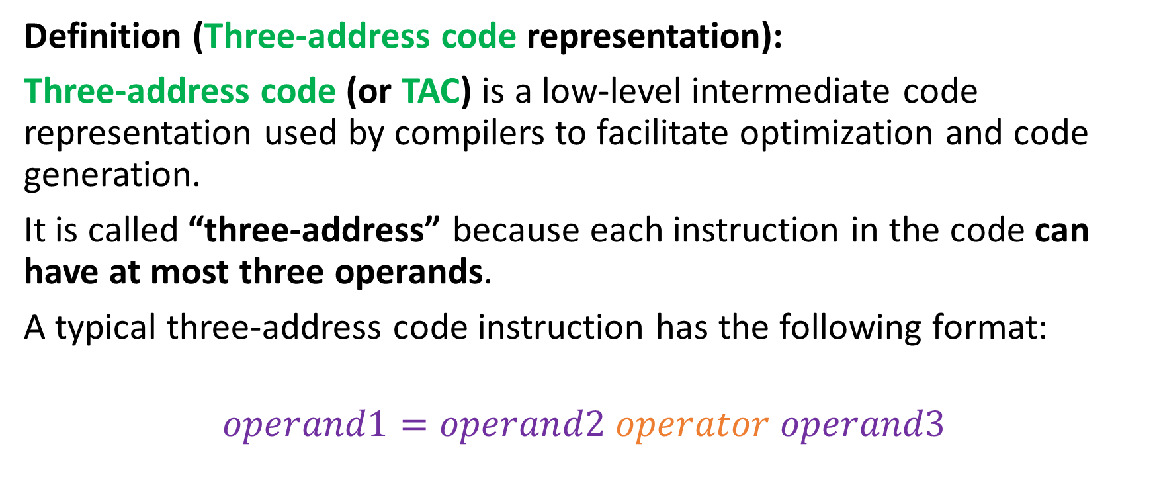
Three-address code representation
Definition (Three-address code representation):
Three-address code (or TAC) is a low-level intermediate code representation used by compilers to facilitate optimization and code generation.
It is called “three-address” because each instruction in the code can have at most three operands.
A typical three-address code instruction has the following format:
$$operand1=operand2 operator operand3$$

Slide 69
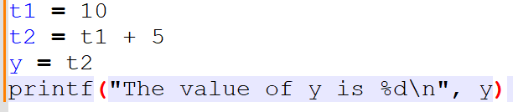
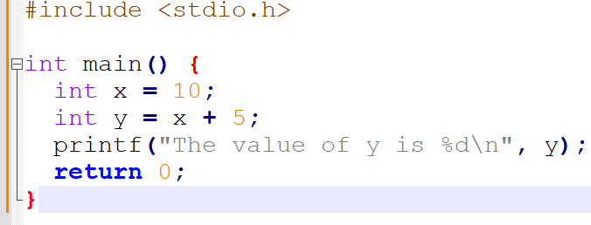
Three-address code representation
For instance, the C code below can be transformed…
…into its equivalent three-address code representation.

Slide 70
From CFG to SDT to IR?!
A blast from the past (W9S2).
We managed to find a derivation for the string “26*5+7” and built an Abstract Syntax Tree for this derivation…
Having an AST, following from using SDT Rules on our Parse Tree/CFG, brings us very close to being able to produce an Intermediate Code Representation!
i1 = 26
i2 = 5
t1 = i2
t2 = t1*i1
i3 = 7
t3 = i3
e1 = t3
e = t2 + e1
I1.val = 26
I2.val = 5
T1.val = I2.val
T2.val = T1.val*I1.val
I3.val = 7
T3.val = I3.val
E1.val = T3.val
E.val = T2.val + E1.val

Slide 71
TAC generation for SDT expressions
Our SDT expressions are quite close to the TAC expressions already.
All we need is:
A simple mapping to translate our SDT elementary operations into their TAC equivalents (SDT: e.val = a.val + b.val → TAC: e:= a + b).
A function that will correctly link variables using the edges of our abstract syntax tree. And a function that will open registers _tn to store variable values and keep a counter on n.
We do not even need to verify that the SDT code is legal! (already guaranteed by previous steps that brought us to the SDT code!)
Could be easily implemented (but would require an implementation of an abstract syntax tree object during parsing, which we did not do!).

Slide 72
A quick note before we start
An important note before we start
When generating IR at this level, you do not need to worry about optimizing it, as long as it produces the correct outcome.
It is okay to generate IR that has lots of unnecessary assignments, redundant computations, uses many temporary variables, etc.
In the next lecture, we will discuss how to optimize IR code (aka. The middle-end part of the compiler).
Optimization is tricky, but interesting!

Slide 73

CFG for TAC
Technically, the three-address code has a syntax and CFG of its own.
P → SP | $ε$
S → id := id op id
S → id := op id
S → id := id
S → push id
S → if id goto L
S → L:
S → jump L
id → (any identifier name)
id → (any constant literal)
op → (any basic operator e.g. +, -, *, /, ==, <, ||, &&, etc. )
L → L0 | L1 | … (block name)
Normally, many more production rules for S…

Slide 74
Basic block in TAC
Definition (basic block in TAC):
A basic block consists of a sequence of instructions in TAC, with:
No labels (except at the first instruction),
No jumps (except at the last instruction of the block).
Core idea behind basic blocks:
Cannot jump in the middle of a basic block, only the beginning,
Cannot jump out of a block, except at the end of it,
Basic block is then a single-entry and single-exit code segment.

Slide 75
Basic block in TAC
A basic block always writes as:
Start with a block name, by convention, in the form of Ln, with n an integer.
Has elementary operations in TAC format.
Could have conditional structures, using if.
Goto/jump could reference current block or another block.
L0:
…
L1:
x := x - 1
z := x > 0
if z goto L1
jump L2
L2:
…

Slide 76
Basic block in TAC
Question: Which C code could have potentially generated this TAC?
L0:
…
L1:
x := x - 1
z := x > 0
if z goto L1
jump L2
L2:
…

Slide 77
Basic block in TAC
Question: Which C code could have potentially generated this TAC?
int x = 4;
… (Some code L0)
do {
x = x - 1
} while (x > 0)
… (Some more code in L2)
L0:
…
L1:
x := x - 1
z := x > 0
if z goto L1
jump L2
L2:
…

Slide 78
Control flow graph
L0:
x := 1
i := 1
L1:
x := x*x
i := i+1
if i < 10 goto L1
jump L2
L2:
y := 10
Definition (control-flow graph):
A control-flow graph is a directed graph with basic blocks as nodes, and an edge from block A to block B if the execution can pass from the last instruction in A to the first instruction in B.
E.g., the last instruction in A is jump LB and execution can fall-through from block A to block B.
Used for if/for/while/functions!

Slide 79
Conclusion
Finished with the front-end part of the compiler.
Can now safely check if a code is legal or not.
The SDT/AST gives us a solid candidate for a first translation, using an intermediate language of some sort.
Easily done with a mapping of some sort.
Curious about how the generation of the TAC code is done using a mapping on the SDT instructions? → Check bonus slides attached to today’s lecture (tough!).

Slide 80
Quiz time!
Which of the following best describes the structure of a three-address code?
Three operands and one operator
Two operands and two operators
One operand and three operators
Three operands and no operator

Slide 81
Quiz time!
Which of the following best describes the structure of a three-address code?
Three operands and one operator
Two operands and two operators
One operand and three operators
Three operands and no operator

Slide 82
Quiz time!
In the context of three-address code, what is the purpose of the "basic block" concept?
To define a sequence of code with a single entry and exit point
To divide code into smaller, manageable units for optimization
To handle loops and conditional statements correctly
All of the above
None of the above

Slide 83
Quiz time!
In the context of three-address code, what is the purpose of the "basic block" concept?
To define a sequence of code with a single entry and exit point
To divide code into smaller, manageable units for optimization
To handle loops and conditional statements correctly
All of the above (more on B in the next lecture!)
None of the above

Slide 84
Quiz time!
Which of the following is NOT a common operation that can be implemented using three-address code?
Arithmetic operations
Conditional jumps
Loops
Dynamic memory allocation

Slide 85
Quiz time!
Which of the following is NOT a common operation that can be implemented using three-address code?
Arithmetic operations
Conditional jumps
Loops
Dynamic memory allocation (that is something the backend will have to resolve later on during register allocation!)

